Slide 1
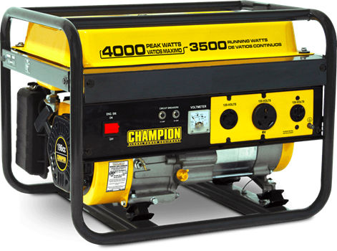
Iterators and Generators
NEXT
NEXT
NEXT
NEXT
Kate and Ajan
NEXT
NEXT
NEXT
NEXT
NEXT
NEXT
NEXT
credit: Ellen/Yannan/Dalton/Annie (Sp 2018),
uh the rest of staff

Slide 2
Iterables
Anything that has some elements that can be looped over is an iterable
You can call iter()on an iterable to get an iterator.
Some examples of iterables:
strings
lists
dictionaries

Slide 3
Iterators
An iterator is an object that keeps track of a location in an iterable
Think of it like a bookmark: If an iterable is a book, an iterator for that book is its bookmark.
You can have many bookmarks in the same book, each with a unique location
You can call next()on any iterator to get the current element and move the bookmark to the next element
Because iterators are also iterables, you can call iter()on them: it just returns itself (an iterator!)

Slide 4
Iterators
You can call next() on an iterator until it runs out of elements. What happens when you reach the end of a book?
If you call next() on an iterator that has no more elements, it will raise a StopIteration. If this is uncaught, this is a Python error and your program will stop!
You have to use a try/except block to catch this error before it halts your program. This is how for loops work. They call next() in a try block and catch the inevitable StopIteration exception.

Slide 5
A Diagram
Iterables
Iterators
next()
iter()

Slide 6
Another Diagram
Iterables
Every Iterator is an Iterable
Every Generator is an Iterator
The reverse is not true!
More on Generators later
Iterators
Generators

Slide 7
Extras
Calling list()on any iterable will first call iter()on it, then calls next() repeatedly until StopIteration and collects the returned elements into a list.
Calling list()on an iterator will do the same thing (because iterators are iterables), but watch out! Calling iter()on an iterator does not “refresh” the bookmark, so it will start where it left off. It will also permanently move the bookmark to the end!
Why?

Slide 8
A Small Example
>>> lst = [1, 2, 3, 4, 5, 6, 7]
1
2
3
4
5
6
7

Slide 9
A Small Example
>>> lst = [1, 2, 3, 4, 5, 6, 7]
>>> i1 = iter(lst)
1
2
3
4
5
6
7

Slide 10
A Small Example
i1
>>> lst = [1, 2, 3, 4, 5, 6, 7]
>>> i1 = iter(lst)
1
2
3
4
5
6
7

Slide 11
A Small Example
i1
>>> lst = [1, 2, 3, 4, 5, 6, 7]
>>> i1 = iter(lst)
>>> i2 = iter(lst)
1
2
3
4
5
6
7

Slide 12
A Small Example
i1
>>> lst = [1, 2, 3, 4, 5, 6, 7]
>>> i1 = iter(lst)
>>> i2 = iter(lst)
1
2
3
4
5
6
7
i2

Slide 13
A Small Example
i1
>>> lst = [1, 2, 3, 4, 5, 6, 7]
>>> i1 = iter(lst)
>>> i2 = iter(lst)
>>> i3 = iter(i2)
1
2
3
4
5
6
7
i2

Slide 14
A Small Example
i1
>>> lst = [1, 2, 3, 4, 5, 6, 7]
>>> i1 = iter(lst)
>>> i2 = iter(lst)
>>> i3 = iter(i2)
>>> next(i1)
1
2
3
4
5
6
7
i2

Slide 15
A Small Example
i1
>>> lst = [1, 2, 3, 4, 5, 6, 7]
>>> i1 = iter(lst)
>>> i2 = iter(lst)
>>> i3 = iter(i2)
>>> next(i1) 1
1
2
3
4
5
6
7
i2

Slide 16
A Small Example
i1
>>> lst = [1, 2, 3, 4, 5, 6, 7]
>>> i1 = iter(lst)
>>> i2 = iter(lst)
>>> i3 = iter(i2)
>>> next(i1) 1
>>> lst[0] = 33
1
2
3
4
5
6
7
i2

Slide 17
A Small Example
i1
>>> lst = [1, 2, 3, 4, 5, 6, 7]
>>> i1 = iter(lst)
>>> i2 = iter(lst)
>>> i3 = iter(i2)
>>> next(i1) 1
>>> lst[0] = 33
33
2
3
4
5
6
7
i2

Slide 18
A Small Example
i1
>>> lst = [1, 2, 3, 4, 5, 6, 7]
>>> i1 = iter(lst)
>>> i2 = iter(lst)
>>> i3 = iter(i2)
>>> next(i1) 1
>>> lst[0] = 33
>>> next(i2)
33
2
3
4
5
6
7
i2

Slide 19
A Small Example
i1
>>> lst = [1, 2, 3, 4, 5, 6, 7]
>>> i1 = iter(lst)
>>> i2 = iter(lst)
>>> i3 = iter(i2)
>>> next(i1) 1
>>> lst[0] = 33
>>> next(i2) 33
33
2
3
4
5
6
7
i2

Slide 20
A Small Example
i1
>>> lst = [1, 2, 3, 4, 5, 6, 7]
>>> i1 = iter(lst)
>>> i2 = iter(lst)
>>> i3 = iter(i2)
>>> next(i1) 1
>>> lst[0] = 33
>>> next(i2) 33
>>> next(i1)
33
2
3
4
5
6
7
i2

Slide 21
A Small Example
i1
>>> lst = [1, 2, 3, 4, 5, 6, 7]
>>> i1 = iter(lst)
>>> i2 = iter(lst)
>>> i3 = iter(i2)
>>> next(i1) 1
>>> lst[0] = 33
>>> next(i2) 33
>>> next(i1) 2
33
2
3
4
5
6
7
i2

Slide 22
A Small Example
i1
>>> lst = [1, 2, 3, 4, 5, 6, 7]
>>> i1 = iter(lst)
>>> i2 = iter(lst)
>>> i3 = iter(i2)
>>> next(i1) 1
>>> lst[0] = 33
>>> next(i2) 33
>>> next(i1) 2
>>> next(i1)
33
2
3
4
5
6
7
i2

Slide 23
A Small Example
i1
>>> lst = [1, 2, 3, 4, 5, 6, 7]
>>> i1 = iter(lst)
>>> i2 = iter(lst)
>>> i3 = iter(i2)
>>> next(i1) 1
>>> lst[0] = 33
>>> next(i2) 33
>>> next(i1) 2
>>> next(i1) 3
33
2
3
4
5
6
7
i2

Slide 24
A Small Example
i1
>>> lst = [1, 2, 3, 4, 5, 6, 7]
>>> i1 = iter(lst)
>>> i2 = iter(lst)
>>> i3 = iter(i2)
>>> next(i1) 1
>>> lst[0] = 33
>>> next(i2) 33
>>> next(i1) 2
>>> next(i1) 3
>>> next(i2)
33
2
3
4
5
6
7
i2

Slide 25
A Small Example
i1
>>> lst = [1, 2, 3, 4, 5, 6, 7]
>>> i1 = iter(lst)
>>> i2 = iter(lst)
>>> i3 = iter(i2)
>>> next(i1) 1
>>> lst[0] = 33
>>> next(i2) 33
>>> next(i1) 2
>>> next(i1) 3
>>> next(i2) 2
33
2
3
4
5
6
7
i2

Slide 26
A Small Example
i1
>>> lst = [1, 2, 3, 4, 5, 6, 7]
>>> i1 = iter(lst)
>>> i2 = iter(lst)
>>> i3 = iter(i2)
>>> next(i1) 1
>>> lst[0] = 33
>>> next(i2) 33
>>> next(i1) 2
>>> next(i1) 3
>>> next(i2) 2
>>> next(i3)
33
2
3
4
5
6
7
i2

Slide 27
A Small Example
i1
>>> lst = [1, 2, 3, 4, 5, 6, 7]
>>> i1 = iter(lst)
>>> i2 = iter(lst)
>>> i3 = iter(i2)
>>> next(i1) 1
>>> lst[0] = 33
>>> next(i2) 33
>>> next(i1) 2
>>> next(i1) 3
>>> next(i2) 2
>>> next(i3) 3
33
2
3
4
5
6
7
i2

Slide 28
What Would Python Display?
>>> lst = [1, 5, 4, 3]
>>> i = iter(lst)
>>> next(i)
>>> j = iter(lst)
>>> next(j)

Slide 29
What Would Python Display?
>>> lst = [1, 5, 4, 3]
>>> i = iter(lst)
>>> next(i)
1
>>> j = iter(lst)
>>> next(j)
1

Slide 30
What Would Python Display?
>>> lst = [1, 2, 3, 4, 5]
>>> i = iter(lst)
>>> next(i)
>>> next(i)
>>> for _ in range(len(lst)):
print(next(i))

Slide 31
What Would Python Display?
>>> lst = [1, 2, 3, 4, 5]
>>> i = iter(lst)
>>> next(i)
>>> next(i)
>>> for _ in range(len(lst)):
print(next(i))
3
4
5
Error (StopIteration)

Slide 32
What Would Python Display?
>>> lst = [1, 2, 3, 4, 5]
>>> i = iter(lst)
>>> next(i)
>>> next(i)
>>> for k in i:
print(k)

Slide 33
What Would Python Display?
>>> lst = [1, 2, 3, 4, 5]
>>> i = iter(lst)
>>> next(i)
>>> next(i)
>>> for k in i:
print(k)
3
4
5

Slide 34
What Would Python Display?
>>> obj = SomeObj()
>>> i = iter(obj)
>>> next(obj)

Slide 35
What Would Python Display?
>>> obj = SomeObj()
>>> i = iter(obj)
>>> next(obj)
Error (obj is not an iterator)

Slide 36
Generators
Generator functions are created using the traditional function definition syntax in Python (def) with the suite of the function containing one or more yield statements.
When a generator function is called, it returns a generator object (an iterator).
It is not until next is called on this generator object that the suite of the function is evaluated.

Slide 37
Generators
def generator(x):
1 / 0
yield x
>>> x = generator(5) # What happens ???

Slide 38
Generators
def generator(x):
1 / 0
yield x
>>> x = generator(5) # What happens?
Won’t error! Why?
‘It is not until next is called on this generator object that the suite of the function is evaluated.’

Slide 39
Generators
def generator(x):
1 / 0
yield x
>>> x = generator(5) # What happens?
>>> next(x) # Calling next(x) will error!
ZeroDivisonError: divison by zero
What happened? The suite of the function was evaluated when we called ‘next’.

Slide 40
Generators
Generator objects run up to and including a yield statement, then stop until called again.
The yield statement pauses the function, yields the value (operates like a return statement), saves the local state so that evaluation can be resumed.
It will start running again at the line right after the most recently returned yield statement.

Slide 41
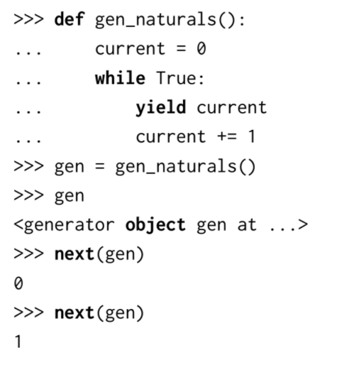
Generators
Generators allow for lazy evaluation (only calculated upon request - streams do this too!).
This is useful, because we can have infinite generators…
It’s common to use/see “while True:” in generator implementations.

Slide 42
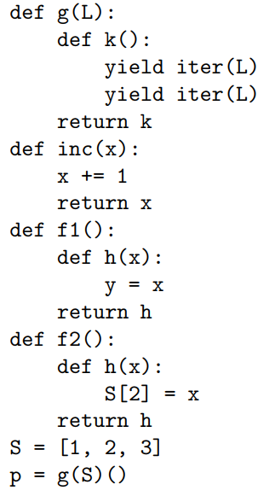
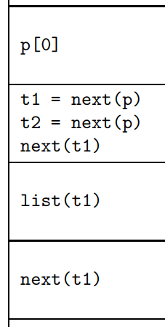
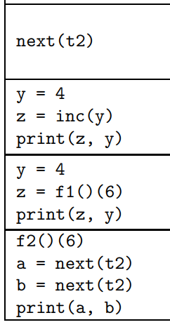
Practice: WWPD (Spring 2017 Q1)
Notes:
Doesn’t fit on slide lol
lol

Slide 43
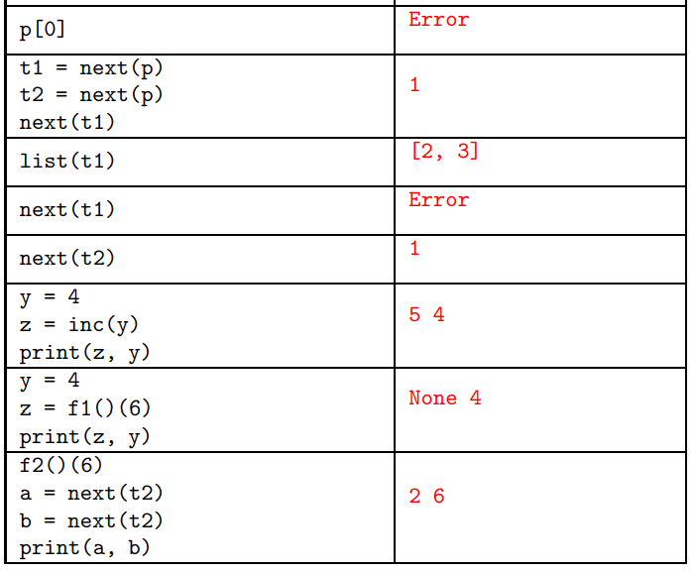
Practice: WWPD (Spring 2017 Q1)
Notes:
Doesn’t fit on slide lol
lol

Slide 44
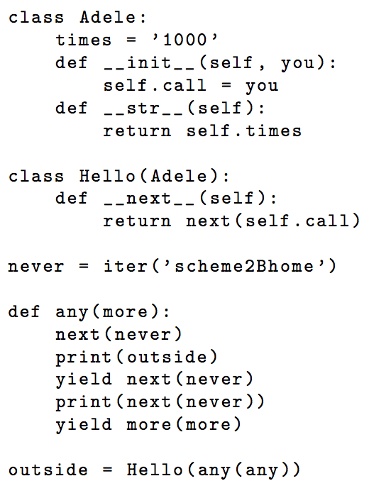
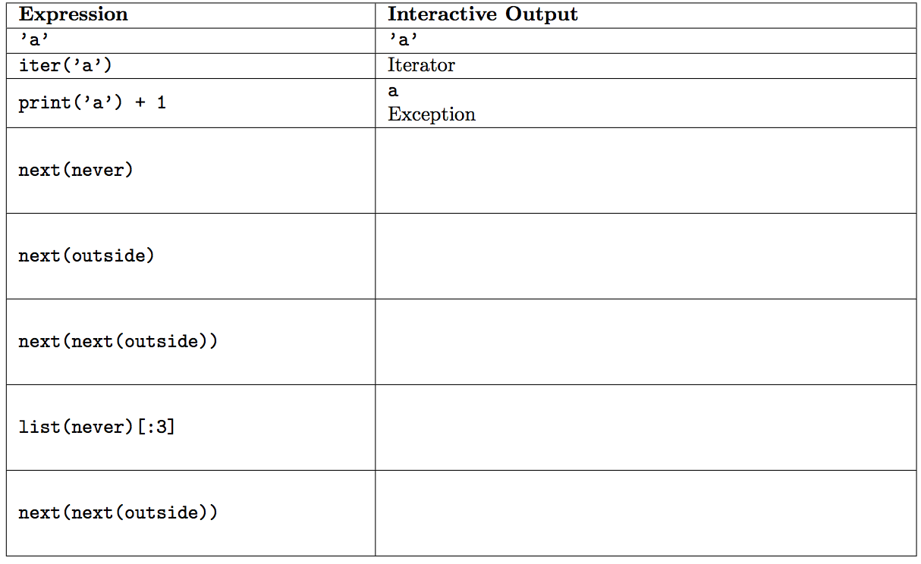
Practice: WWPD (spicy edition) (Fall 2015)
Notes:
Doesn’t fit on slide lol
lol

Slide 45
Practice: WWPD (spicy edition) (Fall 2015)
‘s’
1000
‘h’
e
1000
‘e’
[‘2’, ‘B’, ‘h’]
Exception
Notes:
Doesn’t fit on slide lol
lol

Slide 46
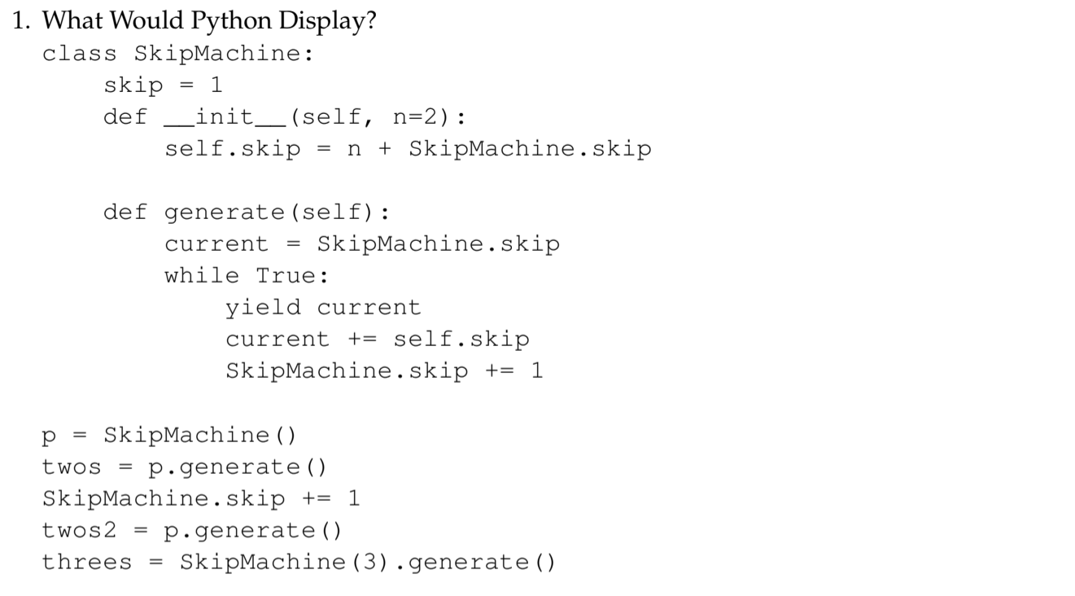
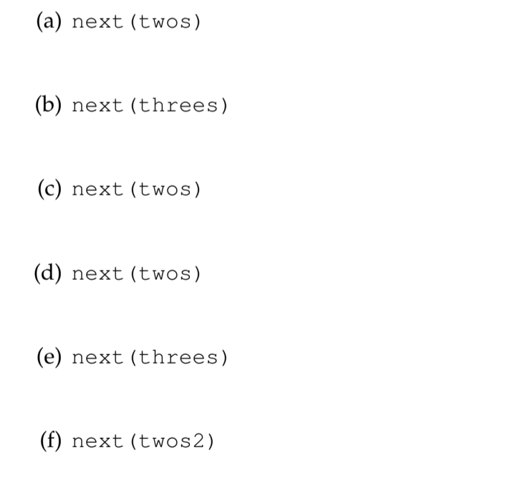
Practice: SkipMachine (from CSM FInal Review Worksheet)

Slide 47
Practice: SkipMachine (from CSM FInal Review Worksheet)
next(twos) 2
next(threes) 2
next(twos) 5
next(twos) 8
next(threes) 7
next(twos2) 5

Slide 48
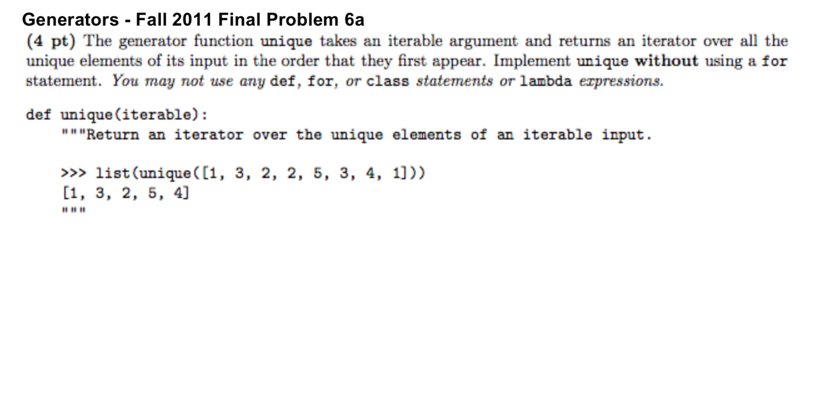
Practice: unique (from Fall 2011 Final - 6a)

Slide 49
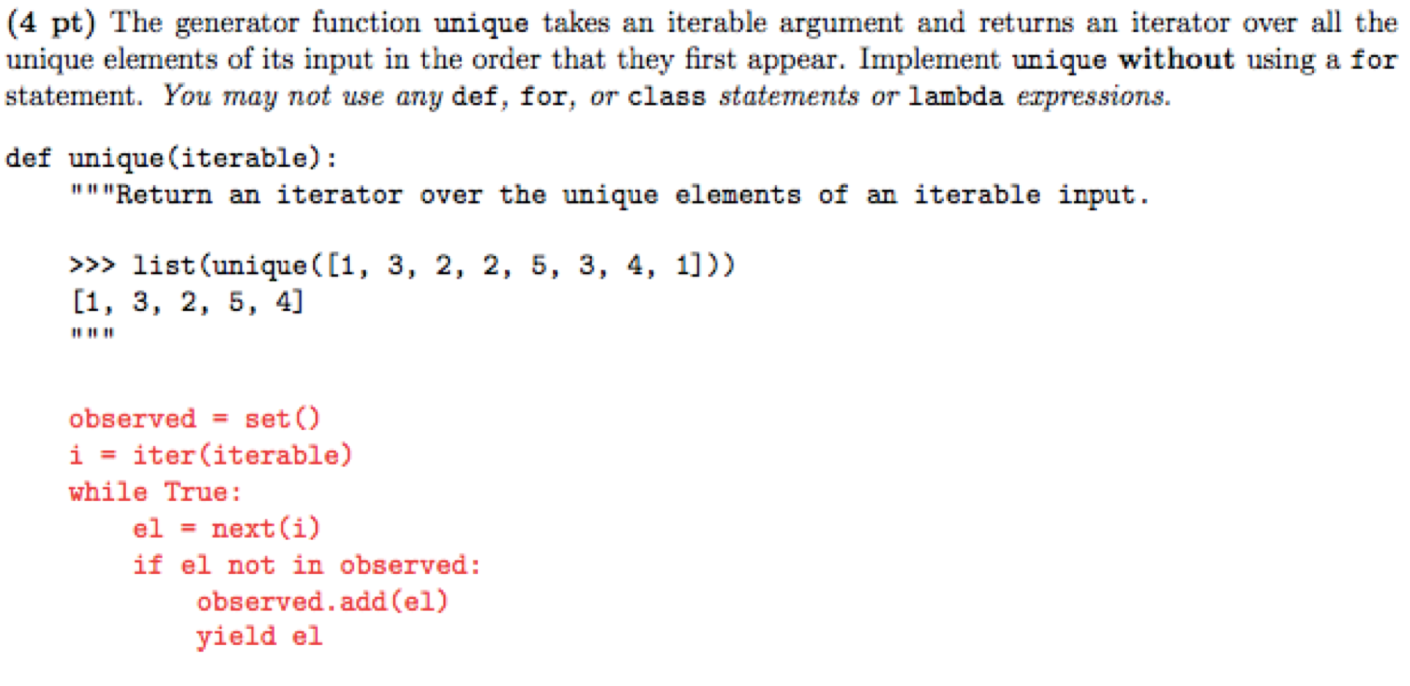
Practice: unique (sol) (from Fall 2011 Final - 6a)

Slide 50
Practice: More Questions!
https://inst.eecs.berkeley.edu/~cs61a/sp18/assets/pdfs/exam_prep10.pdf
(Compilation of other past exam problems - solutions are in their respective exam solutions!)
Notes:
Doesn’t fit on slide lol
lol

Slide 51

Thanks for coming everyone!! Good luck on finals :)

